Slide 1
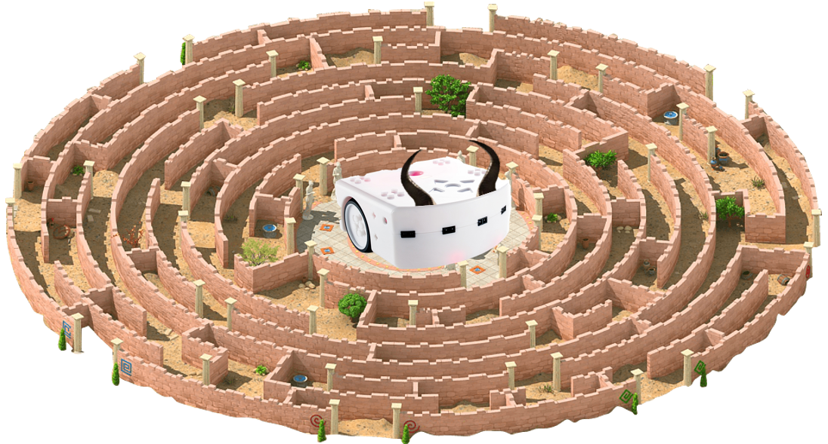
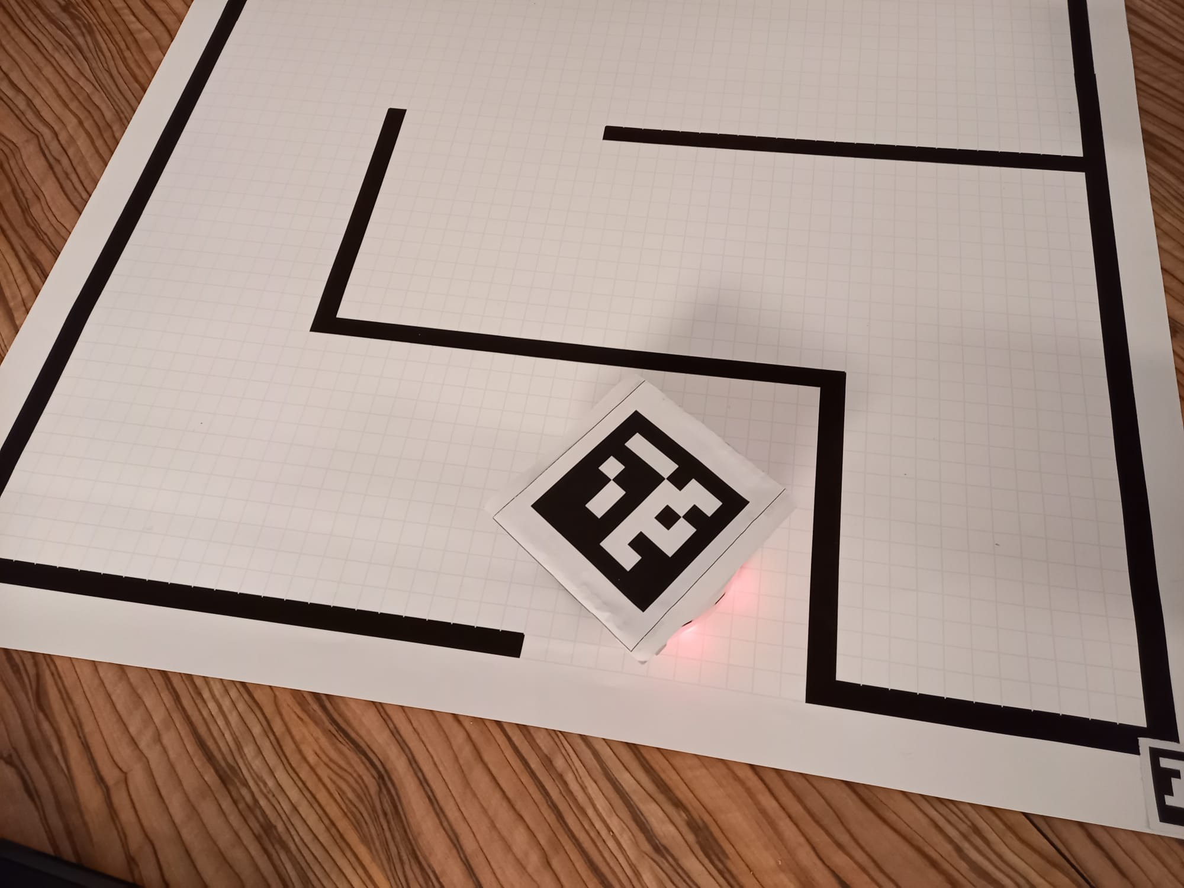
Thyminotaur – Εscaping the maze
Mobile robotics project presentation
Date: December 16th, 2021
Authors: Stephen Monnet, David Rüegg, Julien Burkhard, Sylvain Jacquart

Slide 2
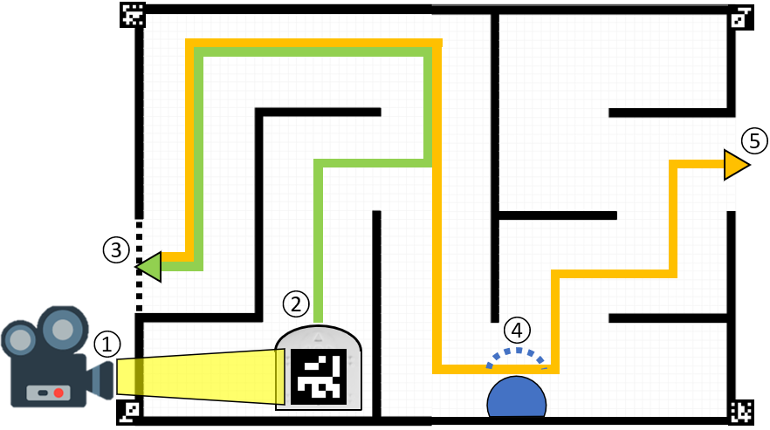
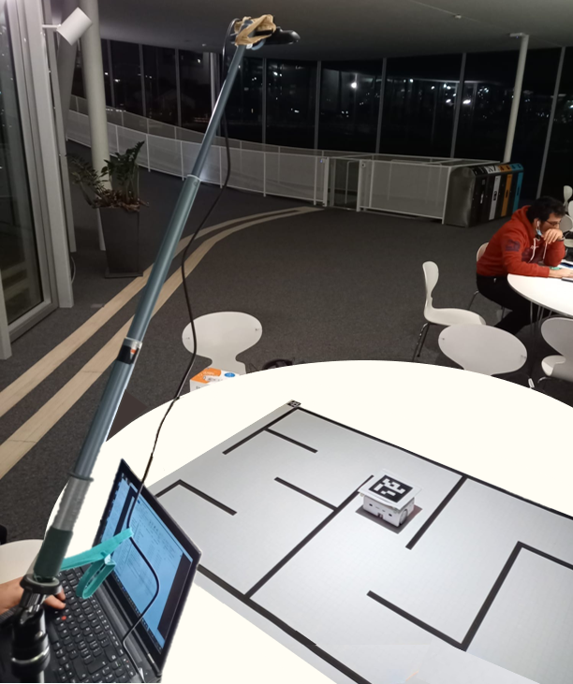
Global project presentation
① Camera detection ② Path to nearest exit
③ Path recompilation ④ Obstacle avoidance ⑤ End on exit

Slide 3
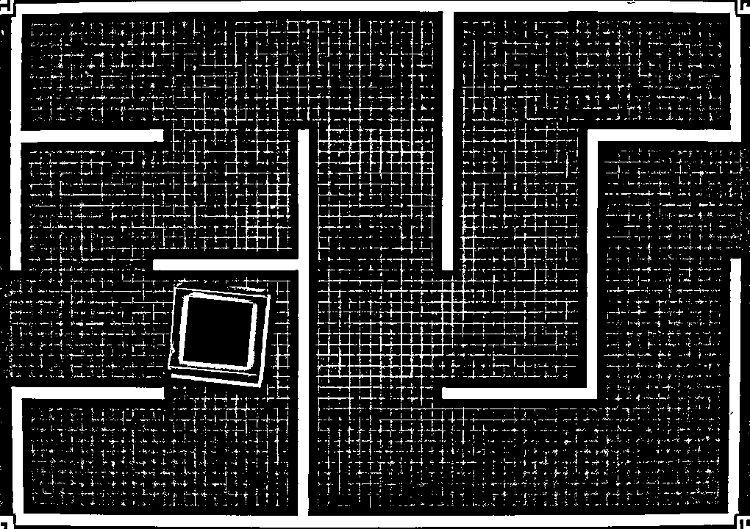
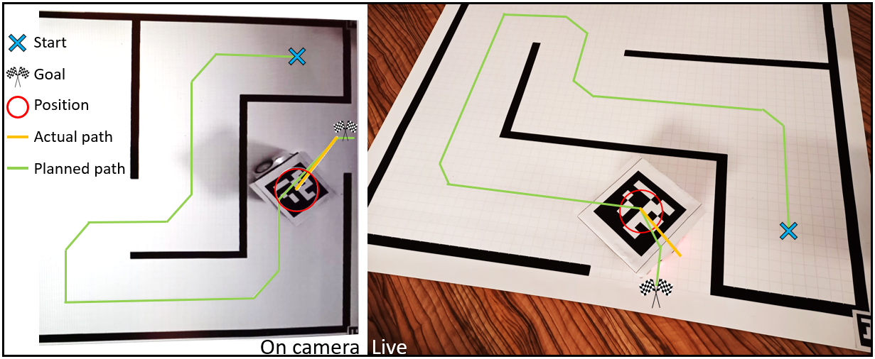
Vision part
Camera calibration
Global navigation

Slide 4
Motion
Local navigation
Motion control

Slide 5
Kalman filtering

Slide 6
Live demo (back-up video)

